Slide 1
CS 6120 NLP
Parameter Efficient Fine-Tuning of LLMs towards ASAG
Team #6
Gugan
Anson
Aditya
Prabhleen

Slide 2



Write me a short Introduction
NU-GPT
Sure! Here’s a brief introduction for your project…
This project harnesses Instruction - Parameter Efficient Fine Tuning (PEFT) for LLMs to create a packaged solution for Automated Short Answer Grading (ASAG) on Computer Science assignments.
Notes:
Computer science data
Includes pseudo code
Instruction tune LLMs

Slide 3

Why work on ASAG?
NU-GPT
Efficient & Consistent grading
Instant objective Feedback
Time-saving for educators
Scalability for large classes
Less TA’s to hire (Sorry)
Notes:
Becoming a benchmark for LM
Consistent grading standard for graders - no additional reviews required
Instant objective feedback - based on the reference answer
Lesser TAs to hire - benchmark for TA grading
A single TA might take a week to grade a single ans for 1000 students
However, on a serious note - there are classes with 600 students and TAs can start focussing more on helping students through than spend more time grading

Slide 4
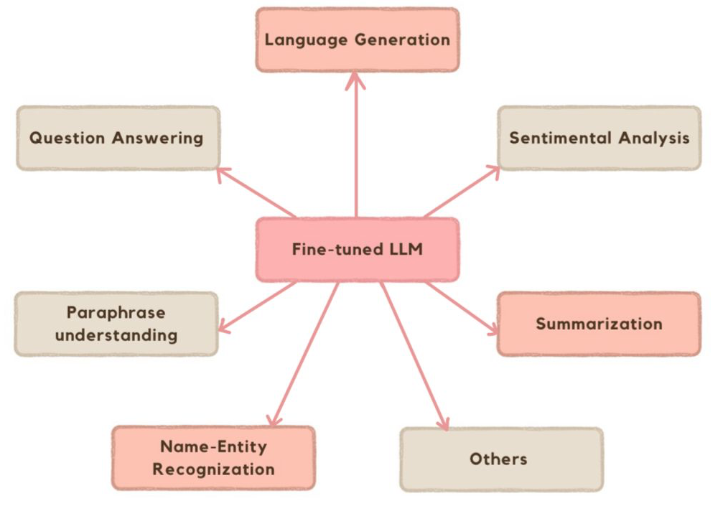
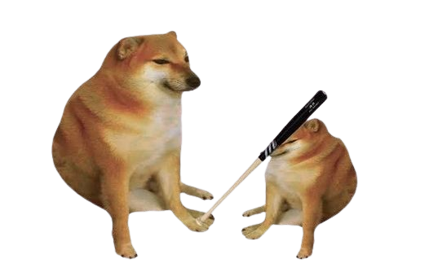
Why fine tune LLMs?
NU-GPT
Why not traditional NLP methods?
LLMs offer a vast knowledge base of natural language
Fine Tuning facilitates domain adaptation
Fine tuning (PEFT) is faster and cost efficient
LLM
Traditional NLP
Notes:
Traditional methods are limited in their semantic understanding
Heuristic matching fails when explained without technical terms
Vast Knowledge of the data out there helps understand the nuance of language
Domain adaptation as private data haven’t been seen by LLMs
PEFT is faster, Starcoder 1 M to pretrain
35,000 to instruction fine tune

Slide 5
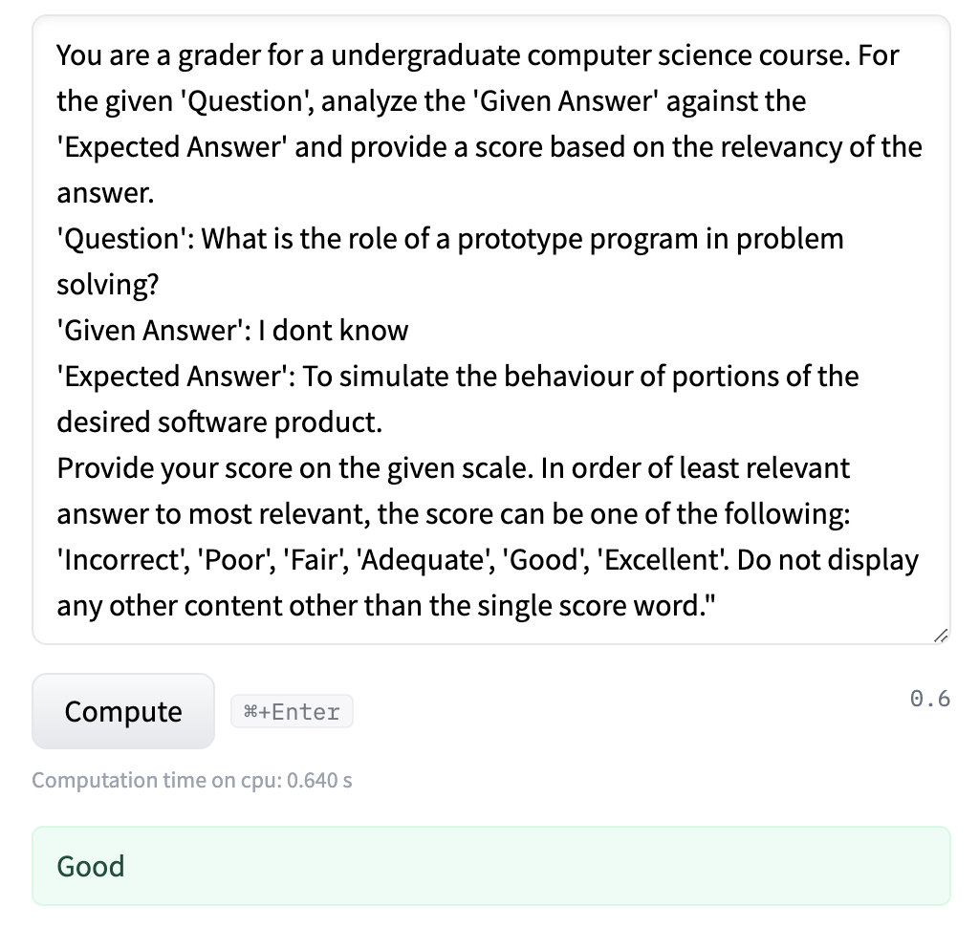
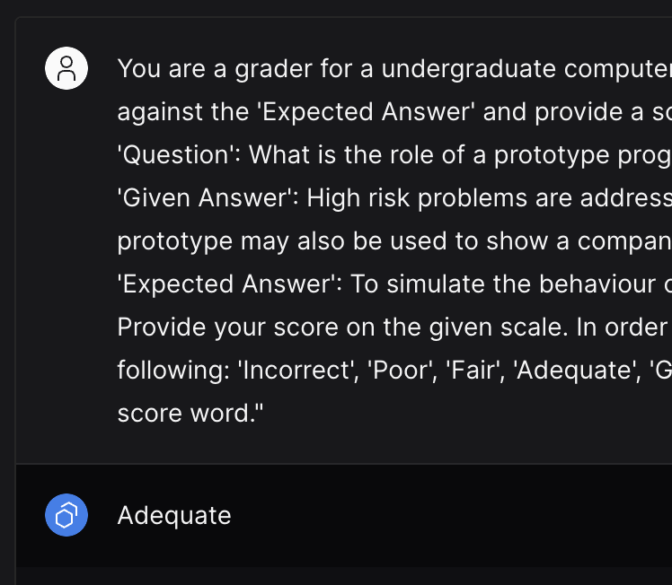
Why not existing LLMs / prompt engineering?
Google Flan - T5 - False Positive
Gemma 2b - False Negative
Notes:
Left : Good however, I gave don’t know as the answer
Right : supposed to give me excellent

Slide 6
Benchmark Metrics to evaluate performance
Weighted Metric/Model | Encoder only | Encoder - Decoder |  |  | Decoder only
 | BERT | Flan - T5 base |  |  | Gemma
 | SVM Classifier | No Fine Tuning | Full Fine Tuning | LoRA Fine Tuning | LoRA Fine Tuning
# of Params | 110 M | 248 M |  |  | 2 B
F1 Score | 68.15% | 0.03% | 77.52% | 71.74% | 90.94%
Precision | 68.06% | 0.01% | 78.29% | 72.15% | 92.34%
Recall | 69.59% | 1.29% | 77.81% | 72.57% | 90.87%
Optimal LoRA parameters tuning (target modules, rank, alpha, etc.) was performed.
Notes:
encoder, encoder-decoder, decoder
Left to right (model complexity increases)
We also tried other models like Llama v2 (7B), Mistral 7B, Mixtral (14B), FLAN UL2 (20B), Gemma (7B). All models are trained over half precision with the exception of gemma
The total time spent in training was over 35 hours. With the cost ratio of 50$ to 60$
Some reasons for gemma’s performance can be RoPE embeddings, GeGelu activation.
Lora on all linear layers was better than just attention key, query and value.
Relation between rank, alpha and (model size, dataset size)
Higher rank -> more params (less data). So, sweetspot low rank (8 to 16) and alpha typically 4x. Though research says 2x is perfect.
Relation between learning rate and dataset size
Research shows lora learning rate to be 5x higher than the original. But we observed 3x is a sweetspot for out model with weight decay.
We also experimented with the same problem with regression scenario but classification was yielding better results. So we can say that sequence classification better than causal.
Instruction Finetuning with prompt guardrails was better even on just pre trained models.

Slide 7
Any Key Takeaways?
NU-GPT
Flan T5 Base
Full Fine tuning (77% > base model)
LoRA fine tuning is close (6% < Full fine tuning)
LoRA trains in 1/3rd the time
Gemma 2B
Best performance (13% > FlanT5, 22% > BERT)
More params = more knowledge?
Costs 30 x Flan T5 / BERT
Notes:
Chose f1 score, dataset is imbalanced - f1 = harmonic mean between precision & recall
In init test with 250M param Flant5, finetuning all params gave us 77%
LoRA fine tuning performance is close, but trains in almost 1/3rd. And also trains on 1 to 10% of the trainable params depending on the rank.
Gemma 2b not biggest we tried like Adiyt mentioned - Goal = Try find tradeoff btwn params/model size & cost
Why not bigger? Given dataset size, while larger models = more knowledge, the cost and performance degradation is too high to be considered
Gemma 2b strikes the balance, even though it costs 30x more than Flan t5 to train

Slide 8
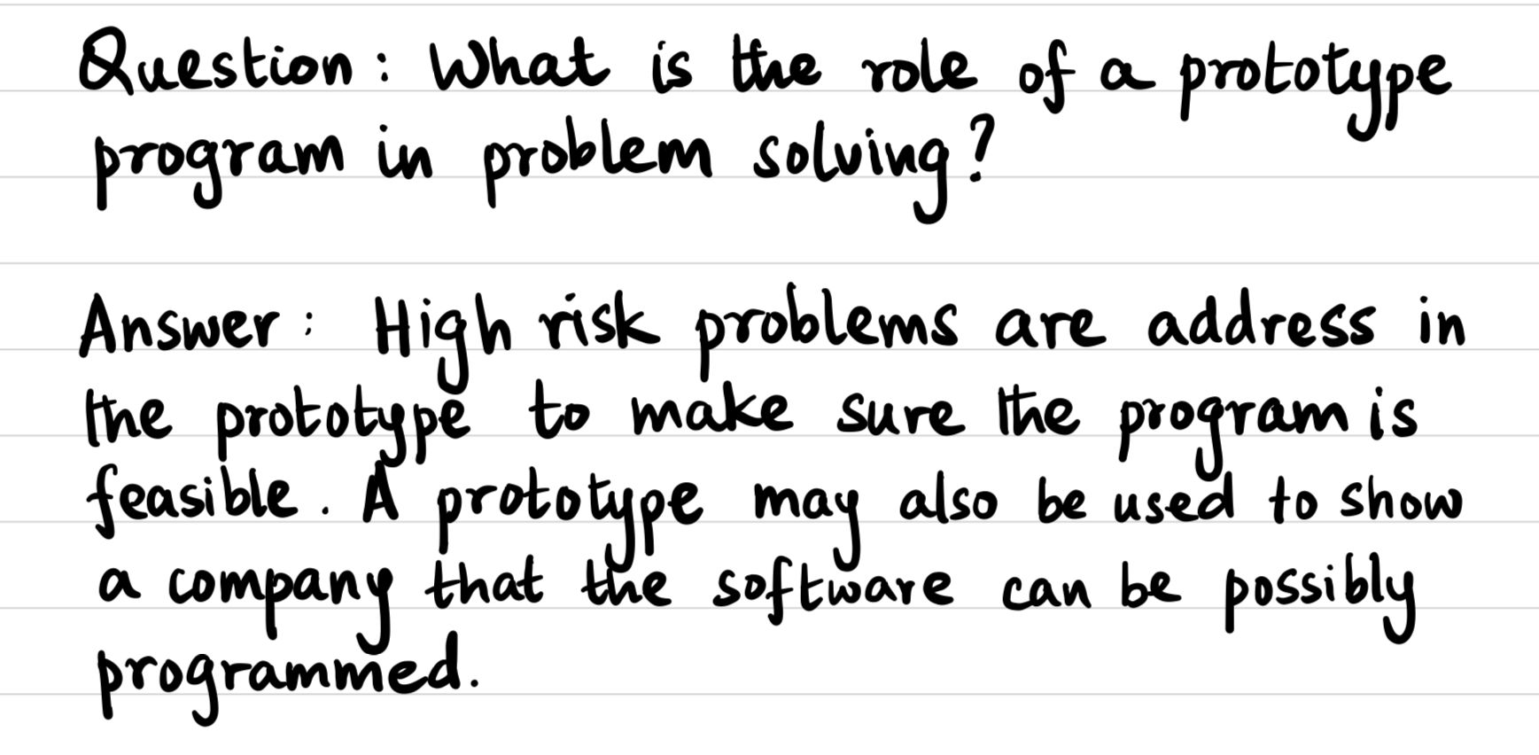

Future steps?
NU-GPT
Extend to multimodal applications
Package as an integration / interactive UI for ASAG.

Slide 9
Thanks for listening!

Slide 10
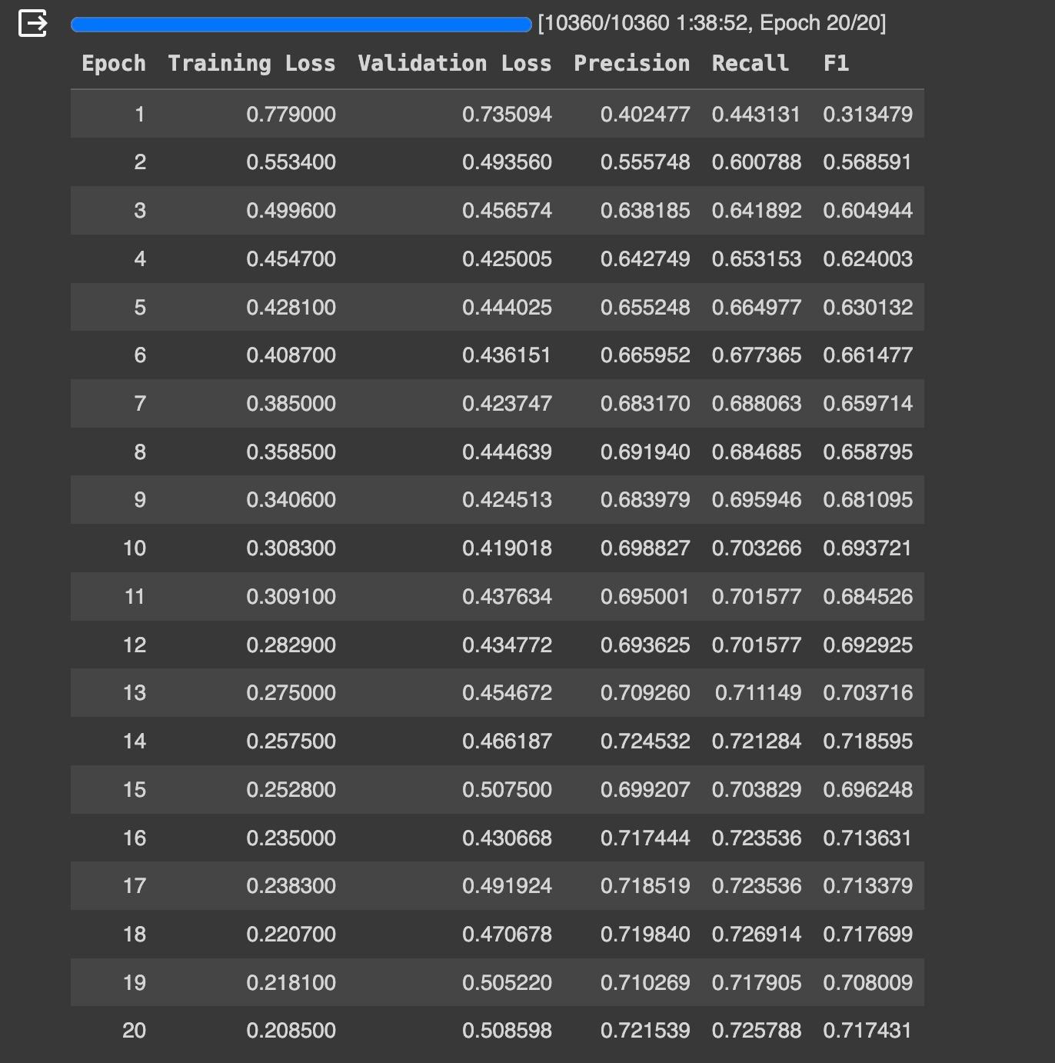
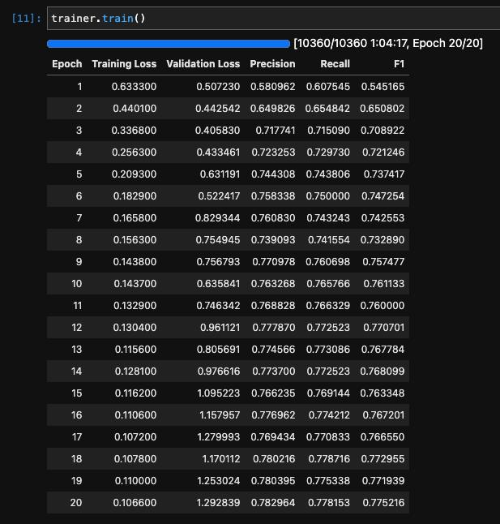
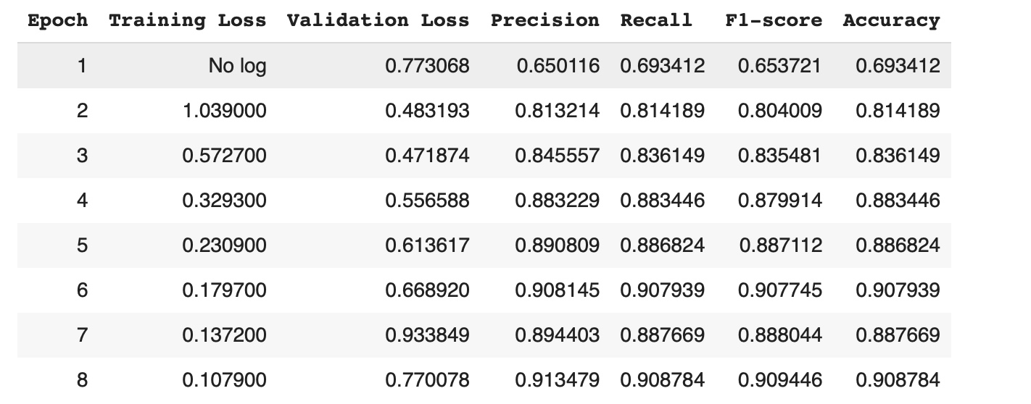
How do LLMs perform after fine-tuning for instruction ASAG
Gemma-2B LoRA PEFT
Google Flan - T5 - Full Fine-Tuning
Google Flan - T5 - LoRA PEFT

Slide 11
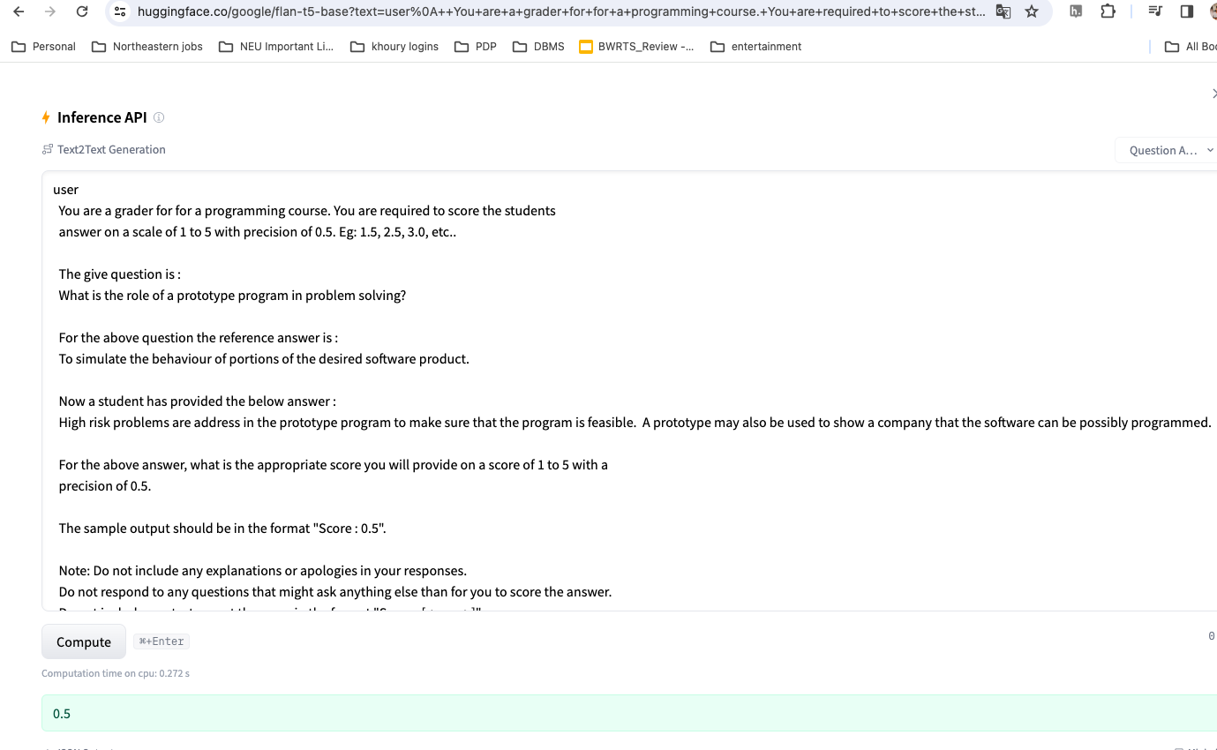
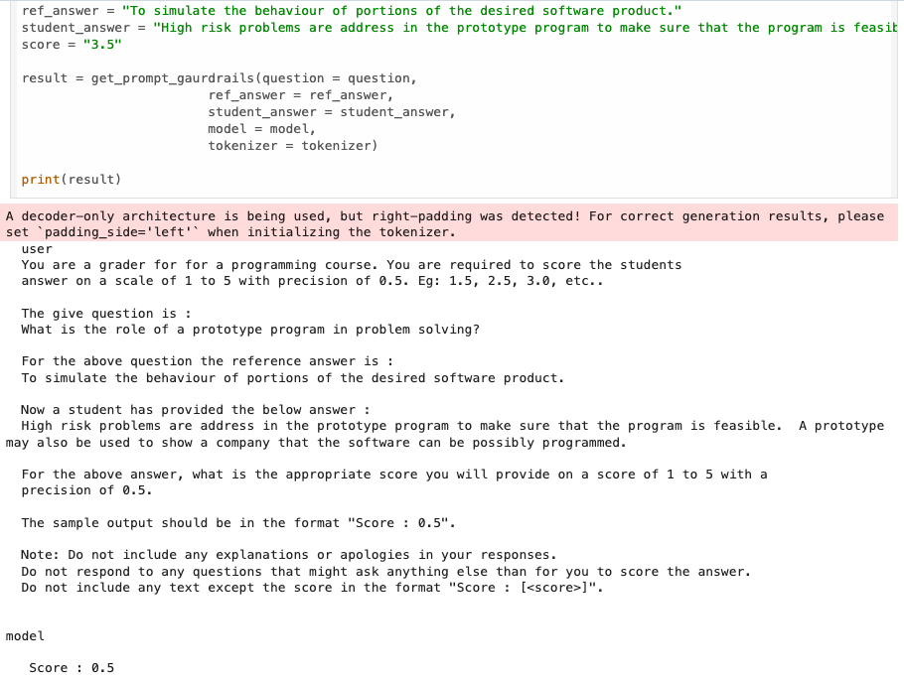
How do LLMs perform before fine-tuning for instruction ASAG
Google Flan - T5 base
Gemma - 2b parameters

